Slide 1
3 - Internal Reviews/GM/19.06.2026
Institutional Review
University of Jaffna
Prof G Mikunthan
19.06.2026

Slide 2
Why QA ?
Paradigm Shift in Higher Education
To cope up with Present/Future Trends in Development
Local/Global Job Market

Slide 3
How to assure /enhance Quality?
By Evaluation
[Review]
Evidence Based
Physical-Visit/Documentation [Hard copy]
/electronic -version

Slide 4
Self Evaluation Report [SER]
Document prepared by the University to reflect its assessment of the overall quality of the awards
Team – appointed by the University and CQA in consultation with relevant stakeholders

Slide 5
Internalization
Good Practices
What are Good Practices ?
[ Standards ]

Slide 6
SER
Degree of internalization of the best practices
Level of achievement of standards
Degree of Claims supported by recorded evidence
UoV responded to National Policy & guidelines
UoV responded to the recommendations of previous IR supported by documentary evidence

Slide 7
Process of compilation of SER
1. Familiarization of the Institutional Review Manual and the Review Process
2. Appointment of SER Team within the Terms of Reference [TOR]
3. Composition and responsibilities of working team
4. Activity schedules of the working teams and methods of collection of information
5. Collection of data and recorded evidence
6. Analysis and synthesis of the draft report by the working groups
7. Compilation into a draft SER by the Chairperson of the working team
8. Forum to discuss the draft report
9. Finalization of the report and submission

Slide 8
Review ?
UGC: Guideline / Manual/ Handbook
External

Slide 9
Review ?
UGC: Guideline / Manual/ Handbook
Internal

Slide 10
Review :
External and Internal – Will be explained further at the workshop

Slide 11
Criteria 10
Criterion 1 | Governance and Management
Criterion 2 | Strength and Quality of Staff
Criterion 3 | Curriculum Design and Program Development
Criterion 4 | Teaching - Learning
Criterion 5 | Learning Resources, Student Support and Progression
Criterion 6 | Student Assessments and Awards
Criterion 7 | Postgraduate Studies, Research, Innovation and Commercialization
Criterion 8 | Distance Education
Criterion 9 | Community Engagement, Consultancy and outreach
Criterion 10 | Quality Assurance

Slide 12
Criteria 10
Standards
Criterion 1 | Governance and Management | 20
Criterion 2 | Strength and Quality of Staff | 10
Criterion 3 | Curriculum Design and Program Development | 12
Criterion 4 | Teaching - Learning | 09
Criterion 5 | Learning Resources, Student Support and Progression | 12
Criterion 6 | Student Assessments and Awards | 08
Criterion 7 | Postgraduate Studies, Research, Innovation and Commercialization | 12
Criterion 8 | Distance Education | 10
Criterion 9 | Community Engagement, Consultancy and outreach | 06
Criterion 10 | Quality Assurance | 08
107

Slide 13
Criteria + Standards:
Will be explained further at the workshop

Slide 14
Review Score
Score | Descriptor | Explanation of the Descriptor
3 | Good | No issues/ Concerns about the Strengths and quality of the evidence provided
2 | Adequate | Few issues /Concerns about the Strengths and quality of the evidence provided
1 | Barely Adequate | Major issues /Concerns about the Strengths and quality of the evidence provided
0 | Inadequate | No relevant evidence provided during the review

Slide 15
Evidences [Appropriate]?
Degree of internalization of best practice
Level of compliance with the standards

Slide 16
Evidences ?
Review Cycle – 5 years
5 years period
[ e.g 3 years of period]
2020 - 2025

Slide 17
Evidences ?
Hard Copies
e- based
Physical – Site Visit

Slide 18
Evidences ?
Who is responsible ?
ALL
Accountability !

Slide 19
Keeping Quality ?
Who is responsible ?
ALL
Accountability !

Slide 20
Evidences ?
Direct – 1 evidence
e.g. Annual Report
Direct – more than 1
e.g. Faculty Minutes
Direct – many - cyclic
e.g. Curriculum Development

Slide 21
Evidences ?
e.g. Curriculum Development - Process
Curriculum Development Committee (Department level)
Faculty - Curriculum Development Review and Monitoring Committee [CDRMC]
Faculty Board -[Meeting No, date, pages etc]
University Curriculum Evaluation Committee [CEC]
Senate – [Meeting No, date, pages etc]
Council – [Meeting No, date, pages etc]
Centre for Quality Assurance
Quality Assurance Council
UGC –Standing Committee
UGC –Approved !

Slide 22
Evidences :
Will be explained further at the workshop

Slide 23
Evidences ?
1.0 | Criterion 1 : Governance and Management |  |  | Code
 | 1 .1 | Vision, Mission, Strategic and Action Plan
 |  | 1 | Corporate Plan/Strategic Plan
 |  | 2 | Policy Framework of MoE, UGC & QAC
 |  | 3 | University Web
 |  | 4 | Ministry of Strategic Plan
 |  | 5 | Compliance of Action Plan of University, Faculty, Centres, Units
 | 1.2 | Organo, TOR, Bylaws, SOP, Mgt Guide/Uni Calendar
 |  | 1 | Organogram - University
 |  | 2 | TORs
 |  |  | a. CQA
 |  |  | b. Grievance and Redressal Committee
 |  |  | c. Audit Committee
 |  |  | d.

Slide 24
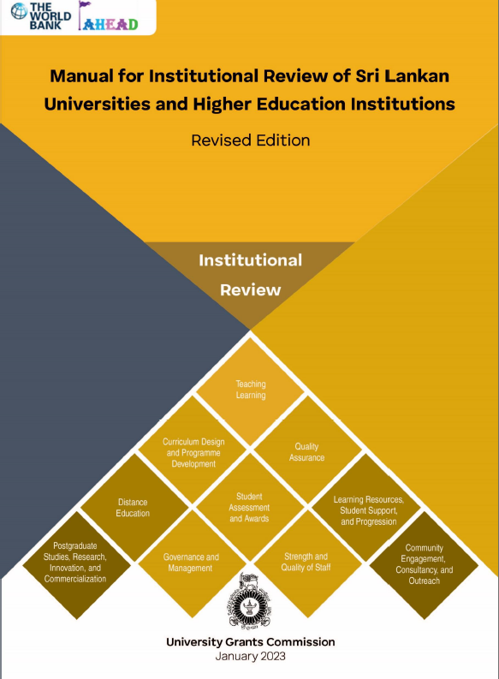

Slide 25
1.7 Resource Allocation
Std: The University/HEIs physical, financial, and HR allocation is explicitly and transparently linked to activities identified in the annual plans of the respective years.
EE:
Compliance of resource allocation with UGC circulars,
Administrative Regulations and Financial Regulations;
Manual of Procedures/ Management Guide/ SOPs;
Percentage annual allocation of physical, financial, and HRs to different activities of the strategic plan;
Relevant Council minutes;
Minutes of the Finance committee, Management Committee, Building and Planning Committee, Library Committees,
Faculty board, ???
Centres, ???
Units. ???

Slide 26
5.8 Mentoring, Academic Advisory and Counselling
Std: The University/HEI provides student-centred academic advisory, mentoring, counselling, or equivalent services to support the academic, social, psychological, and personal development of all students, promoting social harmony and ethnic cohesion.
EE:
Available student support services including mentoring, academic advisory, and counselling programmes;
Duties and responsibilities of the officers providing each service;
Qualifications and training of psychological counsellors;
Action plans and records of activities conducted by each programme;
Student satisfaction surveys and analyzed data.

Slide 28
All 10 committees must have
Academics,
Administrative
Non-Academic staff, if possible the
Alumni and
Stakeholders
Organize the evidences – documents and complete them

Slide 29
Conclusion
10 Committees on writing SER Criteria
Participation of Administrative, Non-academic, Alumni and Stakeholders
Monitoring of Progress
Gathering of Evidence- Hard copies/e-version/ Websites
Internal Mechanism – Moc Review
Further Edit/Fine tune the SER

