Slide 1
Reviews in
Quality Assurance
Prof.G.Mikunthan
19.06.2026 @ 9.00 am

Slide 2
Objectives:
To deepen understanding of the University of Jaffna’s internal quality enhancement standards and criteria.
To systematically evaluate study programs and institutional processes using designated review instruments.
ILOs:
At the end of this work-shop you will be able to
explain the core components, and structure of the University of Jaffna's internal quality enhancement system.
identify the specific roles and responsibilities of the Internal Quality Assurance Unit (IQAU) and Faculty Quality Assurance Cells (FQAC).
differentiate between the criteria, standards, and benchmarks used for Program Review versus Institutional Review.

Slide 3
Contents…
The Quality enhancement system
External Reviews
Subject Review
Institutional Review
Program Review
Reviews in the Past
Current context of Reviews
Internal Review

Slide 4
Abbreviations
PR – Program Review
IR – Institutional Review
IPR – Internal Program Review
IIR – Internal Institutional Review
SER – Self Evaluation Report
CQA – Centre for Quality Assurance
IQACs – Internal Quality Assurance Cells

Slide 5
Quality Education Enhancement System
University Grants Commission
Quality Assurance Standing Committee [UGC]
Quality Assurance Council [QAC]
Centre for Quality Assurance [CQA]
@ University Level
Internal Quality Assurance Cells [IQACs]
@ Faculty Level

Slide 6
Internal Quality Enhancement System
IR UoJ - 2026
Cetre for Quality Assurance [CQA]
University level
Senate [Management] sub- Committee of CQA
Internal Quality Assurance Cells [IQAC]
Faculty level

Slide 7
Review Process
Institutional Review [IR]
University Level
Program Review [PR]
Program Level (Faculty level)
Subject Review [PR]
Subject Level (Dept. level)

Slide 8



Slide 9
Institution [2018]
IR UoJ - 2018
External Review Process
Subject [2012]
Program [2017 -2021]

Slide 10
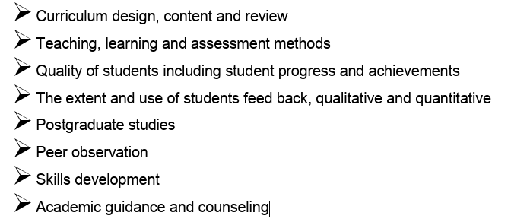
Internal Review – Prof GM
Subject Review – 8 criteria

Slide 11
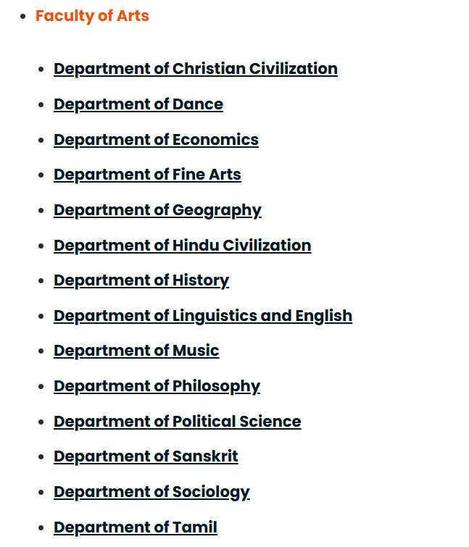
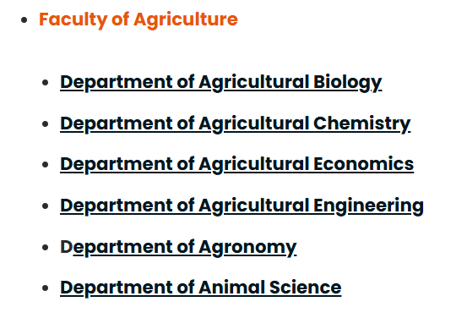
Subjects Review
Internal Review – Prof GM

Slide 12
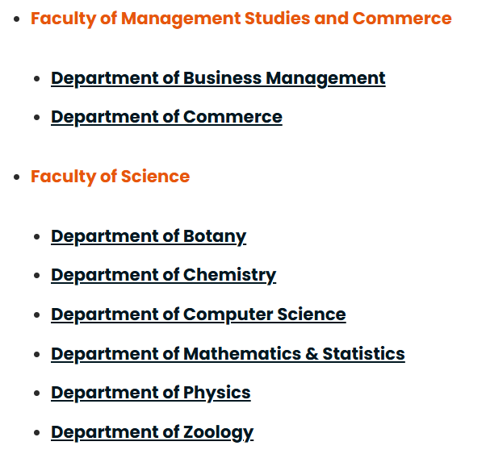
Internal Review – Prof GM

Slide 13
Program [2017 - 2023]
2017 –Arts [Social Sciences & Humanities] [Except Education]
2018 – Law, Fine Arts, Management studies & Commerce, Business studies
2019 – Medicine, Allied Health sciences, Agriculture

Slide 14
Program [2017 - 2023]
2020 – Siddha Medicine
2021 – ?
2022 – Engineering, Science
2023 – CODL

Slide 15
Summary of Program Reviews of the Undergraduate programs held in 2017, 2018 & 2019
Faculties/Unit | Year Reviewed | Grades Obtained
 |  | A | B | C | D
Agriculture | 2019 |  | 1
Allied Health Sciences | 2019 |  | 1 | 2
Arts | 2017 | 1 | 6 | 11 | 5
Ramanathan Academy of Fine Arts | 2017 |  |  | 1 | 2
Business Studies | 2018 | 1
Management Studies and Commerce | 2018 | 1 | 1
Medicine | 2019 |  | 1
Siddha Medicine | 2019 |  |  | 1
Engineering | 2021
Science | 2021
 | A+B =13= 37% |  |  | C+D=22= 63%
A ≥ 80 – Very Good, B ≥ 70 - 79 Good, C ≥ 60 – 69 Satisfactory, D ≤ 60 Poor

Slide 16
Quality Assurance - Program Reviews
External review | Programs | Internal Review | Next Round External Review
2017 | Arts (I), RAFA | 2020 | 2022
2018 | Law, Arts (II), Management Studies and Commerce, Business Studies | 2020 | 2023
2019 | Medicine, Agriculture, Allied Health Sciences, Siddha Medicine, | 2022 | 2024
2021/2023 | Engineering, Sciences, Applied Science | 2023 | 2025
Action plans developed in all the programs based on the recommendations of PR reports – to be implemented and Monitored !

Slide 17
Purpose of Self Evaluation Report – IR
To provide the review team - how the University knows that it meets the expectations of stakeholders and the wider society in terms of the standards and Best Practices and those of statutory Professional bodies where relevant
Citation of all pertinent evidence becomes major requirement of SER either in soft form aligned in an order to peruse easily or physically kept (hard copies – site visit)
Review team expects provision of all relevant documentary evidence to support each claim that the University makes with regard to the standards.

Slide 18
Contents of Self Evaluation Report - IR
Introduction to the University/Faculty
a. Vision and mission
b. Brief history of establishment,
Major milestones of development,
Size in terms of faculties, academic departments, units and centers,
Number of students/teachers
Number of administrative and supporting staff
c. Organizational structure
d. Line of responsibilities among its administrative units and committees
e. Description of - the University operates by providing SWOT
f. Brief outline of the process followed to prepare SER (Who involved, what actions taken to gather information)
2. University/Faculty adherence to the Criteria, Standards, list of evidence
3. Conclusion with current actions

Slide 19
Contents of Self Evaluation Report – IR – Internal Review
Introduction to the University/Faculty
a. Vision and mission
b. Brief history of establishment,
Major milestones of development,
Size in terms of faculties, academic departments, units and centers,
Number of students/teachers
Number of administrative and supporting staff
c. Organizational structure
d. Line of responsibilities among its administrative units and committees
e. Description of - the University operates by providing SWOT
f. Brief outline of the process followed to prepare SER (Who involved, what actions taken to gather information)
2. University/Faculty adherence to the Criteria, Standards, list of evidence
3. Conclusion with current actions

Slide 20
Purpose of Self Evaluation Report – PR
To provide the review team - the performance of the programme of study with respect to the eight criteria and the standards thereof.
SER should describe the degree of internalization of best practices and the level of achievement of standards, substantiated with relevant evidence.
Reflect the effectiveness - how the Faculty/University discharges its responsibilities for maintaining quality of academic standards and awards

Slide 21
Citation of all pertinent evidence becomes major requirement of SER either in soft form aligned in an order to peruse easily or physically kept (hard copies – site visit)
Review team expects provision of all relevant documentary evidence to support each claim that the University makes with regard to the standards.

Slide 22
Scope of the SER for PR
Degree of internalization of best practices and level of achievement of standards
Degree of which the claims are supported by documented evidence
Accuracy of the data and statements made in the SER

Slide 23
Contents of Self Evaluation Report – PR – Internal Review
Introduction to the Study Programme
Process of preparing the SER
Compliance with the Criteria and Standards
Summary

Slide 24
Institutional Review / Program Review - External
Self Evaluation Report
Setting goals, operational procedures,
Best practices &
Bench marks
Institution/Program Self Assessment
(on implementation and performance)
in terms of output & outcome
IR/PR Reports
Centre for Quality Assurance/ Faculty

Slide 25
Institutional Review / Program Review - External
Self Evaluation Report
Setting goals, operational procedures,
Best practices &
Bench marks
Institution/Program Self Assessment
(on implementation and performance)
in terms of output & outcome
Desk Evaluation and Visit to virtual platform and site visit
Peer Review Team Report
[EQA Report]
Review of EQA Report by
QA Agency
IR/PR Reports
Feed Back
QAAC Report
Feedback on Quality of Input, Processes, and output/outcomes
CQA/Faculty

Slide 26
Progress Reporting and Monitoring – PR Cycle 1,
IR- Cycle 2
Setting goals, operational procedures,
Best practices &
Bench marks
Institution/Program Self Assessment
(on implementation and performance)
in terms of output & outcome
Progress Reported/
NOT Reported ?
Introducing changes and improvements
Feed Back

Slide 27
Institutional Review / Program Review - Internal
Self Evaluation Report
[Essential information]
Setting goals, operational procedures,
Best practices &
Bench marks
Institution/Program Self Assessment
(on implementation and performance)
in terms of output & outcome
Introducing changes and improvements
Feed Back
Centre for Quality Assurance

Slide 28
Institutional Review / Program Review - Internal
Self Evaluation Report
Setting goals, operational procedures,
Best practices &
Bench marks
Institution/Program Self Assessment
(on implementation and performance)
in terms of output & outcome
Desk Evaluation and Visit to virtual platform and site visit
Peer Review Team Report
[EQA Report]
Review of EQA Report by
QA Agency
IR/PR Reports
Feed Back
QAAC Report
Feedback on Quality of Input, Processes, and output/outcomes
CQA/Faculty

Slide 29

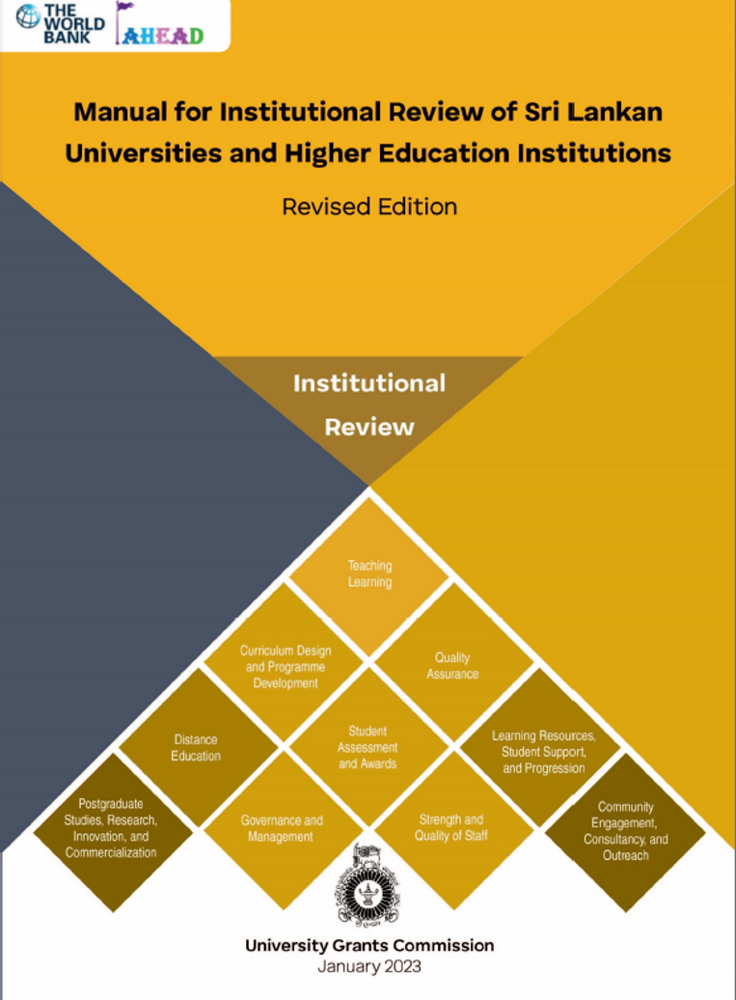
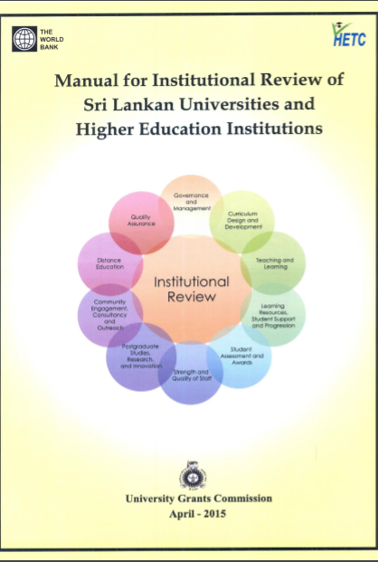
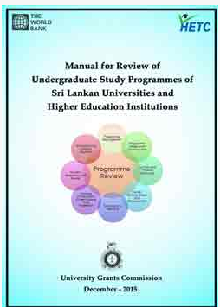
Institutional Review
Program
Review
IR UoJ - 2026
UGC Approval - Awaiting

Slide 30
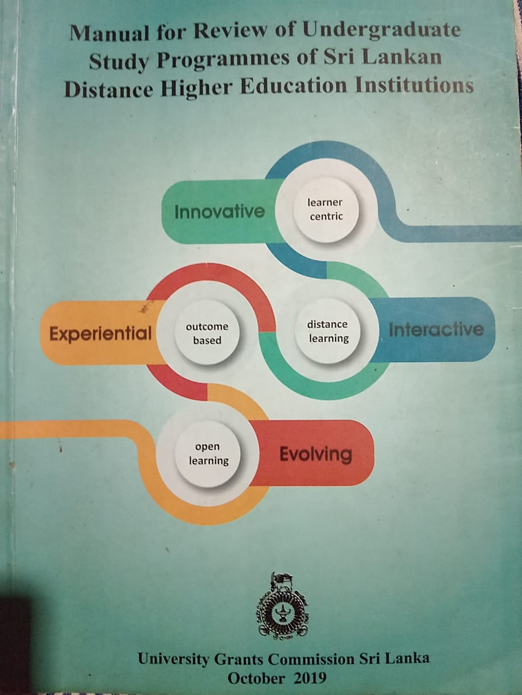
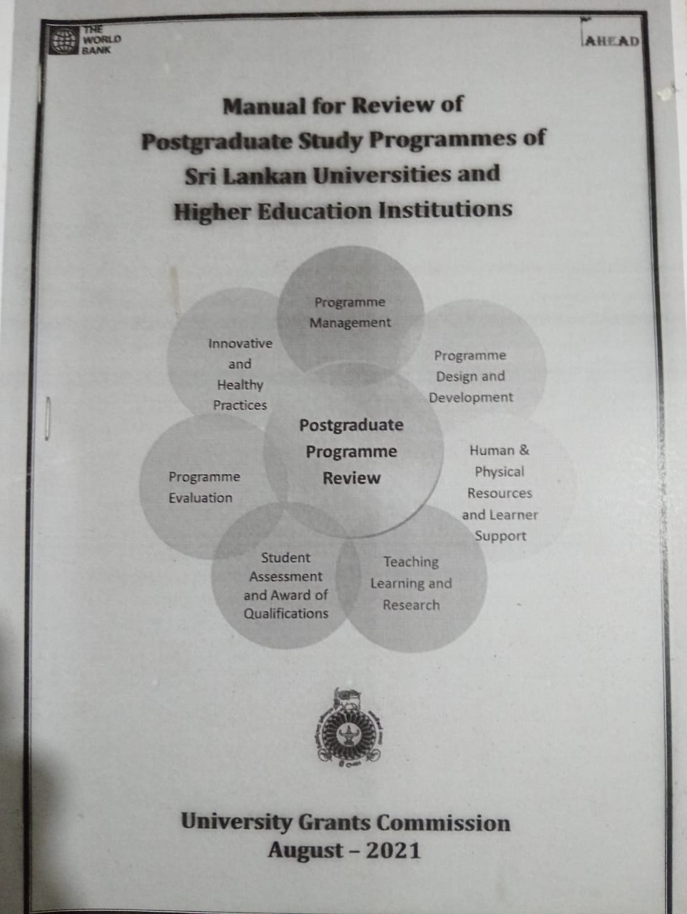

Slide 31


Slide 32
Program Review
[As per PR Manual 2015]
Criteria – 08
Standards - 156

Slide 33
 | Program Review - 8 Committees [Criteria] | No of Standards 2015 | No of Standards 2015
1 | Program Management | 27 | 24
2 | Human and Physical Resources | 12 | 28
3 | Program Design and Development | 24
4 | Course/Module Design and Development | 19
5 | Teaching and Learning | 19
6 | Learning Environment, Student Support and Progression | 24
7 | Student Assessment and Awards | 17
8 | Innovative and Healthy Practices | 14
Total |  | 156

Slide 34
 | Program Review - 6 Committees [Criteria] | No of Standards 2015 | No of Standards 2023
1 | Program Management | 27 | 24
2 | Learning Resources, Learner Support and Progression | 12 | 28
3 | Programme and Course/Module Design and Development | 24 | 25
4 | Teaching and Learning | 19 | 14
5 | Student Assessment method | 19 | 20
6 | Innovative and Healthy Practices | 24 | 13
7 |  | 17
8 |  | 14
Total |  | 156 | 124

Slide 35
Preparation of Self Evaluation Report
Section 1 Brief introduction to the programme of study
Section 2 Review team's observations on the Self -- Evaluation Report (SER)
Section 3 A brief description of the Review Process
Section 4 Overview of the Faculty’s/Institute’s approach to quality and standards
Section 5 Judgment on the degree of internalization of the best practices of the six (6) criteria considered in the undergraduate programme review
Section 6 Grading of Overall Performance of the Programme
Section 7 LQF Level compliance or SLQF Level equivalence of the Qualification
Section 8 Commendations and Recommendations
Section 9 Summary

Slide 36
Institutional Review
Criteria – 10
Standards – 145 [2015]
- 107 [2026]

Slide 37
Institutional Review - 10 Criteria
No of Standards 2015 | No of Standards 2023
29 | 20
15 | 10
10 | 12
14 | 9
15 | 12
11 | 8
25 | 12
6 | 10
13 | 6
7 | 8
1 | Governance and Management
2 | Curriculum Design and Development
3 | Teaching and Learning
4 | Learning Resources, Student Support and Progression
5 | Student Assessment and Awards
6 | Strength and Quality of Staff
7 | Postgraduate Studies, Research, Innovation and Commercialization
8 | Community Engagement, Consultancy and Outreach
9 | Distance Education
10 | Quality Assurance
145
107

Slide 38
Score Guide
0 | 1 | 2 | 3
Score | Descriptor
0 | Inadequate
1 | Barely adequate
2 | Adequate
3 | Good

Slide 39
Review Program Process –
Quality Assurance Council, UGC
Submission of SER for PR/IR
Appointment of External Reviewers
Consent obtained from the faculty – No conflict of interest
Desk Evaluation of SER [by the Reviewers]
Visiting to Evidences online/Site Visit
Report to QAC
Confirmation of Results – External Reviewers
Results in QAC Web.

Slide 41
Table 4.2 IR - Differential weightage of Criteria
 | Total | Weightage on a thousand scale |  | Weighted minimum score | Actual criteria-wise Score
No | Assessment Criteria | 1000 | % | 50% | example
1 | Governance and Management | 180 | 18 | 90 | 134
2 | Curriculum Design and Development | 120 | 12 | 60 | 80
3 | Teaching and Learning | 100 | 10 | 50 | 71
4 | Learning Resources, Student Support and Progression | 80 | 8 | 40 | 56
5 | Student Assessment and Awards | 100 | 10 | 50 | 80
6 | Strength and Quality of Staff | 100 | 10 | 50 | 75
7 | Postgraduate studies, Research, Innovation and Commercialization | 100 | 10 | 50 | 68
8 | Community Engagement, Consultancy and Outreach | 60 | 6 | 30 | 40
9 | Distance Education | 40 | 4 | 20 | 25
10 | Quality Assurance | 120 | 12 | 60 | 90
 |  | 1000 | 100 | 500 | 719 (71.9%)

Slide 42
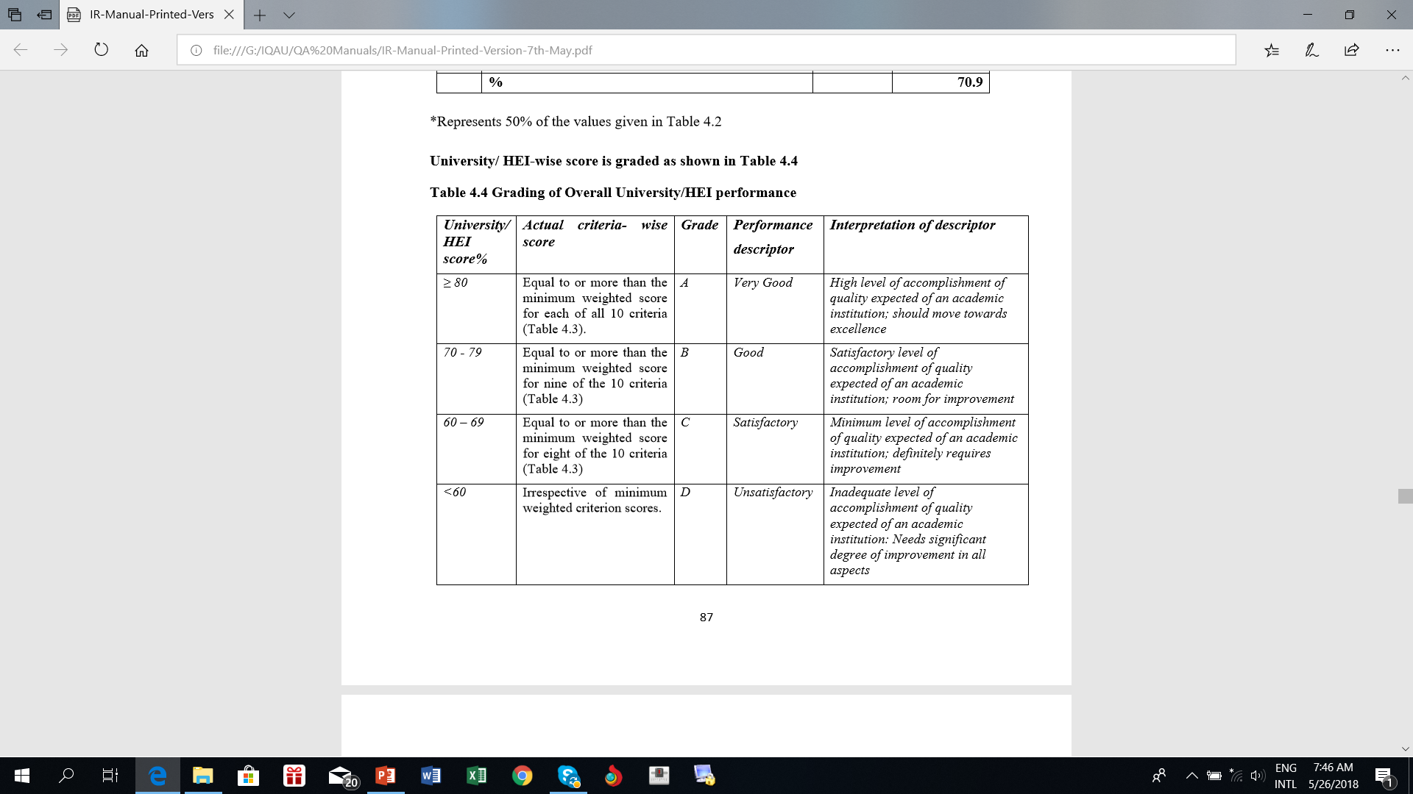

Slide 43
Roles of 4 pillars
Academic
Non-Academic [Administrative/
Academic support staff
Students - Feedback
Alumni – Employability survey /
Stakeholders - feedback

Slide 44
We need get ready for this process !
Voluntary and Active participation is necessary !
Actively involve and gain the experience on the Review process

Slide 45
Thank you

